Slide 1

First Step with ElasticSearch

Slide 2


Materials
My GitHub with materials
ElasticSearch GitHub
Bartosz.loboda1@gmail.com

Slide 3
WHAT WILL YOU LEARN ?
What is Elastic ?
Instalation
API
Indexing
Searching
Mapping
Tools

Slide 4
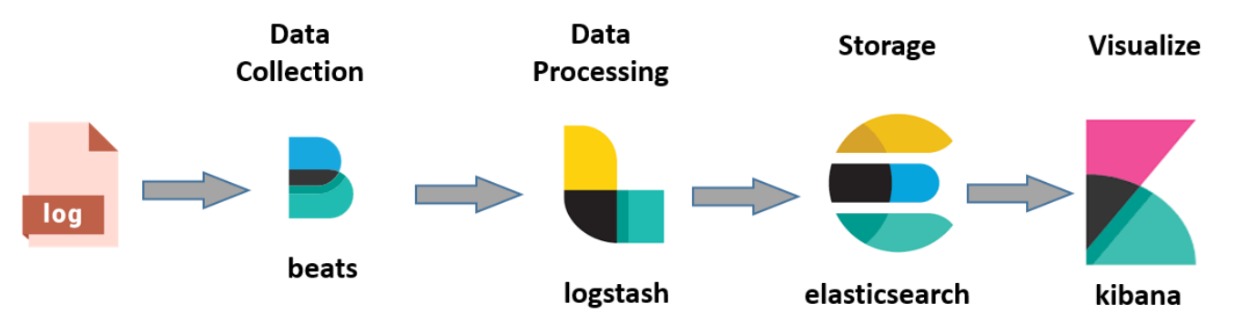
Mostly

Slide 5
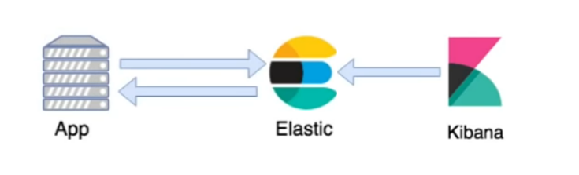
We will Focus on

Slide 6

History
Shay Banon
Abstraction layer for Apache Lucene
First public release came out in februarry 2010
Open Source

Slide 7
ElasticSearch is
Open Source
Java
Scalable
Aims to make full-text easy
Apache Lucene
High Aviailablity
NoSql DB
Inverted indexes
REST api
Analytics engine
Distributed
Near Real Time

Slide 8
Installation
1. Download
2. UnZip
3. Run

Slide 9
Check
$ service elasticsearch status
elasticsearch.service - Elasticsearch
Loaded: loaded (/lib/systemd/system/elasticsearch.service; enabled; preset: enable
Active: active (running) since Thu 2024-05-02 23:09:28 CEST; 15h ago
Docs: https://www.elastic.co
Main PID: 2733 (java)
Tasks: 109 (limit: 9444)
Memory: 2.1G
CPU: 3min 1.547s
CGroup: /system.slice/elasticsearch.service
├─2733 /usr/share/elasticsearch/jdk/bin/java -Xms4m -Xmx64m -XX:+UseSeria>
├─2793 /usr/share/elasticsearch/jdk/bin/java -Des.networkaddress.cache.tt>
└─2816 /usr/share/elasticsearch/modules/x-pack-ml/platform/linux-x86_64/b>

Slide 10
IT’S ALIVE !!
$ curl localhost:9200
{
"name" : "bartek-1-2",
"cluster_name" : "elasticsearch",
"cluster_uuid" : "8zpKnwOaRv2bKY7GgFSBSg",
"version" : {
"number" : "8.13.3",
"build_flavor" : "default",
"build_type" : "deb",
"build_hash" : "617f7b76c4ebcb5a7f1e70d409a99c437c896aea",
"build_date" : "2024-04-29T22:05:16.051731935Z",
"build_snapshot" : false,
"lucene_version" : "9.10.0",
"minimum_wire_compatibility_version" : "7.17.0",
"minimum_index_compatibility_version" : "7.0.0"
},
"tagline" : "You Know, for Search"
}

Slide 11
Basic Terms

Slide 12
WHAT IS A CLASTER ?
The largest unit in Elasticsearch.
Consists of multiple nodes working together to store and process large amounts of data.

Slide 13
WHAT IS A NODE ?
A single instance of Elasticsearch software that can run on a separate machine.
The nodes form a cluster and work together to ensure availability and high performance.

Slide 14
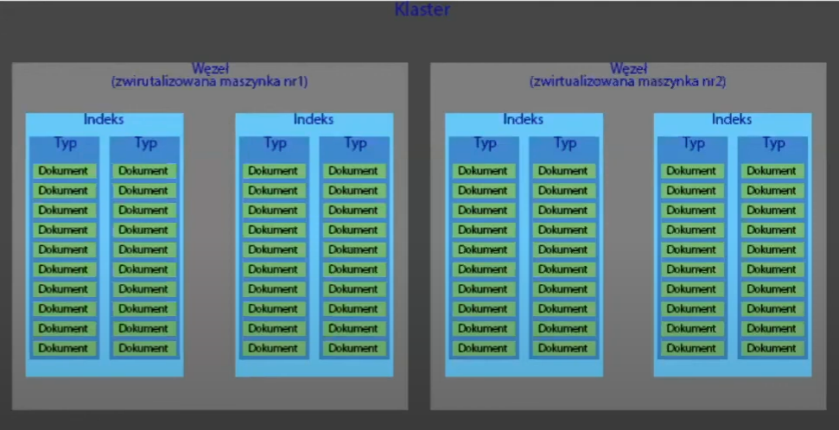

Slide 15
WHAT IS INDEX
An index is collection of documents that have somewhat similar charateristics
An index is stored in a set of shards which are themselves Lucene indices.
ElasticSearch will eventually need to merge results from all the shards it has searched.

Slide 16

WHAT IS A SHARD ?
Each shard is in itself a fully functional and independent "index" that can be hosted on any node in the cluster.

Slide 17
WHAT IS A SHARD ?
Shard is the box in which the parts of the indexes are stored
Each index is stored as a set of shards
Each shard is in itself a fully functional and independent "index" that can be hosted on any node in the cluster.

Slide 18
SHARD SHARDING
Allows to horizontally split/scale your content volume
Allows you to distribute and parallelize operation across shards/ nodes -> incresing performance.

Slide 19
WHAT IS REPLICA ?
It’s a copy of shard
Increases reliability protects against failures
Improves reading performance

Slide 20

INDEX = SHARDS + REPLICS

Slide 21
Index Configuration
$ curl -XPUT "http://localhost:9200/umowa/_settings" -H 'Content-Type: application/json' -d'
{
"index": {
"number_of_replicas": 2,
"number_of_shards": 5
}
}

Slide 22
How do we talk to Elastic
$curl –X <VERBS>
VERBS GET, POST, PUT, DELETE

Slide 23
How do we talk to Elastic
$curl –X <VERBS>< PROTOCOL>
VERBS GET, POST, PUT, DELETE
PROTOCOL http / https

Slide 24
How do we talk to Elastic
$curl –X <VERBS>< PROTOCOL>://<HOST>
VERBS GET, POST, PUT, DELETE
PROTOCOL http / https
HOST node host

Slide 25
How do we talk to Elastic
$curl –X <VERBS>< PROTOCOL>://<HOST>:<PORT>
VERBS GET, POST, PUT, DELETE
PROTOCOL http / https
HOST node host
PORT 9200http api

Slide 26
How do we talk to Elastic
$curl –X <VERBS>< PROTOCOL>://<HOST>:<PORT>/<PATH>
VERBS GET, POST, PUT, DELETE
PROTOCOL http / https
HOST node host
PORT 9200http api
PATH api endpoint eq. /_cat / _plugin

Slide 27
How do we talk to Elastic
$curl –X <VERBS>< PROTOCOL>://<HOST>:<PORT>/<PATH>?<QUERY_STRING>
VERBS GET, POST, PUT, DELETE
PROTOCOL http / https
HOST node host
PORT 9200http api
PATH api endpoint eq. /_cat / _plugin
QUERY_STRING ?pretty (optional)

Slide 28
How do we talk to Elastic
$curl –X <VERBS>< PROTOCOL>://<HOST>:<PORT>/<PATH>?<QUERY_STRING> –d < BODY>
VERBS GET, POST, PUT, DELETE
PROTOCOL http / https
HOST node host
PORT 9200http api
PATH endpoint eq. /_cat /_plugin /_search
QUERY_STRING ?pretty (optional)
BODY json(optional)

Slide 29
WHAT IS DATA ?
{
"umowaId": 1,
"firstName": "Jan",
"name": "Kowalski",
"label": "Jan Kowalski",
"BirthDate": "2000-01-01",
"Price": 1560
}

Slide 30
Mapping
$ curl -XGET "http://localhost:9200/umowa/_mapping?pretty"

Slide 31
{ "umowa" : {
"label" : {
"type" : "text",
"fields" : {
"keyword" : {
"type" : "keyword",
"ignore_above" : 256
}
}
},
"name" : {
"type" : "text",
"fields" : {
"keyword" : {
"type" : "keyword",
"ignore_above" : 256
}
}
},
"price" : {
"type" : "long"
},
"umowaId" : {
"type" : "long"
}
}
}
}
}
"mappings" : {
"properties" : {
"BirthDate" : {
"type" : "date"
},
"birth_date" : {
"type" : "date"
},
"firstName" : {
"type" : "text",
"fields" : {
"keyword" : {
"type" : "keyword",
"ignore_above" : 256
}
}}
},

Slide 32
DEFINED TYPES
String
Dataimes
Whole numbers
Floats
Booleans
Objects
Also
Text/Keyword
Data
Binary/Short/Inteeger/Long
Float/Double
Boolen
Object
Multi_field, ip, geo_points, geo_shape
https://www.elastic.co/guide/en/elasticsearch/reference/current/mapping-types.html

Slide 33
ADD MAPPING
curl -XPUT "http://localhost:9200/umowa2" -H 'Content-Type: application/json' -d ‚
{
"mappings": {
"properties": {
"birthDate": {
"type": "date",
"format": "strict_date_optional_time||epoch_millis"
},
"name": {
"type": "keyword"
},
„umowaId": {
"type": "long"
},
„Price": {
"type": „integer"
}}}}'

Slide 34
ADD SOME DATA
$ curl -XPUT "localhost:9200/umowa/_doc/1?pretty" -H 'Content-Type: application/json' -d '{
"umowaId": 1,
"firstName": "Jan",
"name": "Kowalski",
"label": "Jan Kowalski",
"BirthDate": "2000-01-01",
"Price": 1560
}'
{
"_index" : "umowa",
"_id" : "1",
"_version" : 1,
"result" : "created",
"_shards" : {
"total" : 2,
"successful" : 1,
"failed" : 0
},
"_seq_no" : 0,
"_primary_term" : 1
}
{
Index name
Document ID
Document Version
Results
Information on shard operations: {
Total number of shards
Number of shards successfully served Number of shards that failed to be processed
},
Document sequence numer
Document primary term
}

Slide 35
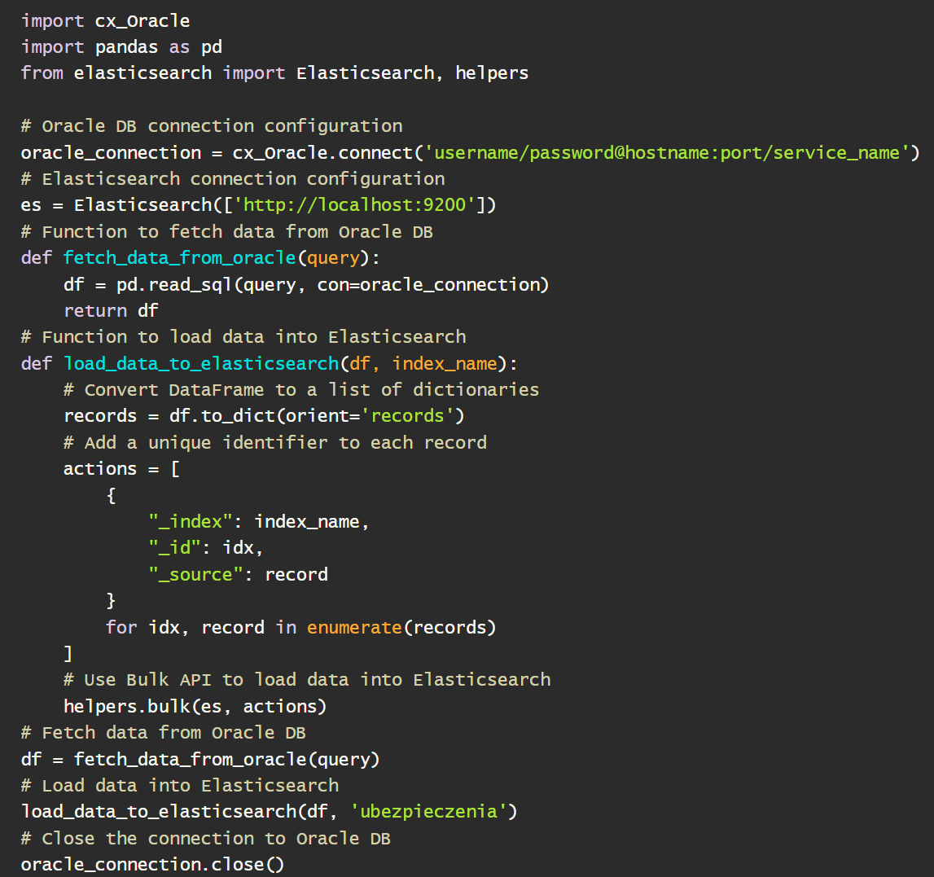
ADD SOME MORE

Slide 36
Read data
$ curl -XGET "localhost:9200/umowa/_doc/1?pretty"
{
"_index" : "umowa",
"_id" : "1",
"_version" : 1,
"_seq_no" : 0,
"_primary_term" : 1,
"found" : true,
"_source" : {
"umowaId" : 1,
"firstName" : "Jan",
"name" : "Kowalski",
"label" : "Jan Kowalski",
"BirthDate" : "2000-01-01„
"Price": 1560
}
}

Slide 37
Read data
curl -XGET "localhost:9200/umowa/_search?size=10&pretty"
{
"took" : 9,
"timed_out" : false,
"_shards" : {
"total" : 1,
"successful" : 1,
"skipped" : 0,
"failed" : 0},
"hits" : {
"total" : {
"value" : 2,
"relation" : "eq"
},
"max_score" : 1.0,
"hits" : [{
"_index" : "umowa",
"_id" : "1",
"_score" : 1.0,
"_source" : {
"umowaId" : 1,
"firstName" : "Jan",
"name" : "Kowalski",
"label" : "Jan Kowalski",
"BirthDate" : "2000-01-01„
"Price": 1560
}
Execution time in milliseconds
Information on exceeding the time limit
Information on the status of task completion
on different parts of the shard
Total number of eligible documents
(value = number of doc)
( relations eq = number of hits)
Section providing information for a particular document

Slide 38
WHAT IS SCORE ?
_score specifies the extent to which the returned document matches the query.
_score is based on term frequency, invers document frequency, and field-lenght norm
https://www.elastic.co/guide/en/elasticsearch/guide/current/relevance-intro.html

Slide 39
Change data
curl -XPOST "localhost:9200/umowa/_update/1?pretty" -H 'Content-Type: application/json' -d '{
"doc": {
"firstName": "Krzysztof" }}'
{
"_index" : "umowa",
"_id" : "1",
"_version" : 2,
"result" : "updated",
"_shards" : {
"total" : 2,
"successful" : 1,
"failed" : 0
},
"_seq_no" : 3,
"_primary_term" : 1
}

Slide 40
Clean it up
$ curl -XDELETE "localhost:9200/umowa/_doc/1"
{"_index":"umowa",
"_id":"1",
"_version":2,
"result":"deleted",
"_shards":{
"total":2,
"successful":1,
"failed":0
},"_seq_no":6,
"_primary_term":3
}
$ curl -XDELETE "localhost:9200/umowa?pretty„
{
"acknowledged" : true
}

Slide 41

HOW TO SEARCH ?

Slide 42
QUERY SYNTAX
URL Search
$ curl -XGET "http://localhost:9200/umowa/_doc/_search?q=name:Kowalczyk&pretty"
Request Body Search
$ curl -X POST "http://localhost:9200/umowa/_doc/_search" -H 'Content-Type: application/json' -d '{
"query": {
"match": {
"name": „Kowalczyk"
}
}
}'

Slide 43
HOW TO SEARCH
$ curl -XGET "localhost:9200/umowa/_search?pretty"
$ curl -XGET "localhost:9200/p*/_search?pretty "
curl -XGET "localhost:9200/_search" -H 'Content-Type: application/json' -d '{
"query": {
"multi_match": {
"query": „Lorem",
"fields": ["field1", "field2", "field3"],
"type": "phrase" }}}'

Slide 44

Demo 1

Slide 45
HOW IT WORKS
Full text search by default!

Slide 46
„A fast red car passed a truck standing on the side of the road”
„The next day, three fast red cars passed trucks standing on the side of the road”
https://www.elastic.co/guide/en/elasticsearch/reference/current/analysis-stop-tokenfilter.html

Slide 47
SEPARATE WORDS / TERMS
A,fast,red,car,passed,a,truck,standing,on,the,side,of,the,road
The,next,day,three,fast,red,cars,passed,trucks,standing,on,the,side,of,the,road
https://www.elastic.co/guide/en/elasticsearch/reference/current/analysis-stop-tokenfilter.html
Notes:
Stemming
Lematyzja
Lowercasing

Slide 48
SORT TERMS
A,a,car,fast,of,on,passed,red,road, side,standing,the,the,truck
cars,day,fast,next,of,on,passed,red,road,side,standing,the,the,The,three,trucks
https://www.elastic.co/guide/en/elasticsearch/reference/current/analysis-stop-tokenfilter.html
Notes:
Stemming
Lematyzja
Lowercasing

Slide 49
Term Document 1 Document 2
A
fast
red
car
cars
passed
truck
trucks
standing
on
the
side
of
the
road
Next
Day
three
a
x
x
x
x
x
x
x
x
x
x
x
x
x
x
x
x
x
x
x
x
x
x
x
x
x
x
x
x
x

Slide 50
Term Document 1 Document 2
fast
red
car
cars
passed
truck
trucks
standing
on
the
side
of
the
road
next
day
three
a
x
x
x
x
x
x
x
x
x
x
x
x
x
x
x
x
x
x
x
x
x
x
x
x
x
x
x
x

Slide 51
Term Document 1 Document 2
fast
red
car
pass
truck
stand
side
next
day
three
road
x
x
x
x
x
x
x
x
x
x
x
x
x
x
x
x
x
x
x
https://www.elastic.co/guide/en/elasticsearch/reference/current/analysis-stop-tokenfilter.html

Slide 52
Analysis
Tokenization + normalization

Slide 53
Standard Analyzer
Standard Tokenizer The,Quick,Brown,Fox,jumped,over,the,Lazy,Dog
Lowercase Filter the,quick,brown,fox,jumped,over,the,lazy,dog
Stopwords Filter ,quick,brown,fox,jumped,over,,lazy,dog

Slide 54

Materials
My GitHub with materials
Pytania i Feedback

Slide 55

Thanks for your attention
Bartosz Łoboda

